Slide 1
Characteristics of Semiconductor junction Diode

Slide 2
What is diode?
In general, all the electronic devices need DC power supply but it is impossible to generate DC power so,
we need an alternative to get some DC power thus the usage of diodes comes into the picture to convert AC power to DC power.
A diode is a tiny electronic component used in almost all the electronic circuits to enable the flow of current in only one direction (unidirectional device).
We can say that the usage of semiconductor materials to build the electronic components was started with diodes.
Few applications of diodes are
rectification, amplification, electronic switch, conversion of electrical energy into light energy and light energy into electrical energy.

Slide 3
Solid materials are generally classified into three types namely
conductors,
insulators and
semi-conductors.
Conductors have a maximum number of free electrons,
Insulators have a minimum number of free electrons (negligible such that flow of current is not at all possible)
where as semi-conductors can be either conductors or insulators depending upon the potential applied to it.
Semi-conductors which are in general use are Silicon and Germanium.
Silicon is preferred because it is abundantly available on the earth and it gives a better thermal range.

Slide 4
Semi-conductors are further classified into two types as Intrinsic and Extrinsic semi-conductors.
Intrinsic Semi-conductors:
These are also called as pure semi-conductors
where charge carriers (electrons and holes) are in equal quantity at the room temperature.
So current conduction takes place by both holes and electrons equally.
Extrinsic Semiconductors:
In order to increase the number of holes or electrons in a material, we go for extrinsic semi-conductors
where impurities (other than silicon and germanium or simply trivalent or pentavalent materials) are added to the silicon.
This process of adding impurities to the pure semi-conductors is called as Doping.

Slide 5
Formation of P and N-type semiconductors:
N-Type Semiconductor:
If pentavalent elements (number of valence electrons are five) are added to the Si or Ge then there are free electrons are available.
As the electrons are more in number these are called as N-type semiconductor.
In N-type, semi-conductor electrons are majority charge carriers and holes are minority charge carriers.
Few pentavalent elements are Phosphorous, Arsenic, Antimony, and Bismuth. these elements are called as Donors.
P-Type Semiconductor
Similarly, if trivalent elements like Boron, Aluminium, Indium, and Gallium are added to Si or Ge, a hole is created because a number of valence electrons in it are three.
Since a hole is ready to accept an electron and get paired it is called as Acceptors.
As the number of holes are excess in newly formed material these are called as P-type semiconductors.
In P-type semi-conductor holes are majority charge carriers and electrons are minority charge carriers.

Slide 6
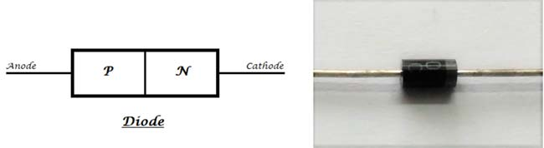
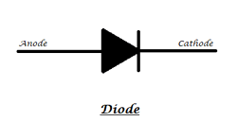
P-N Junction Diode
Now, if we join the two types of semi-conductors P-type and N-type together then a new device is formed called as P-N junction diode.
As the newly formed component can have two terminals or electrodes (one connected to P-type and the other to the N-type)
The terminal connected to P-type material is called Anode and the terminal connected to N-type material is called Cathode.
The symbolic representation of the diode is as follows.
The arrow indicates the flow of current through it when the diode is in forward biased mode, the dash or the block at the tip of the arrow indicates the blockage of current from the opposite direction.
Zero Bias: No external voltage is applied.
Forward Bias: External voltage decreases the built-in potential barrier.
Reverse Bias: External voltage increases the built-in potential barrier.

Slide 7
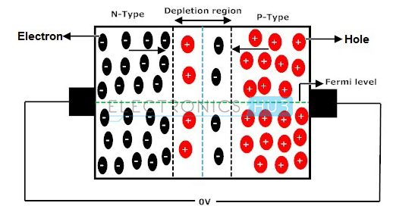
PN Junction Diode When No External Voltage is Applied
In zero bias or thermal equilibrium state junction potential provides higher potential energy to the holes on the P-side than the N-side.
If the terminals of junction diode are shorted, few majority charge carriers (holes) in the P side with sufficient energy to surmount the potential barrier travel across the depletion region.
Therefore, with the help of holes, current starts to flow in the diode and it is referred to as forward current.
In the similar manner, holes in the N side move across the depletion region in reverse direction and the current generated in this fashion is referred to as reverse current.

Slide 8
Potential barrier opposes the migration of electrons and holes across the junction and allow the minority charge carriers to drift across the PN junction.
As a result of it, a state of equilibrium is established when the majority charge carriers are equal in concentration on either side of the junction and when minority charge carriers are moving in opposite directions.
A net zero current flows in the circuit and the junction is said to be in dynamic equilibrium.
By increasing the temperature of semiconductors, minority charge carriers have been continuously generated and thereby leakage current starts to rise.
In general no conduction of electric current takes place because no external source is connected to the PN junction.

Slide 9
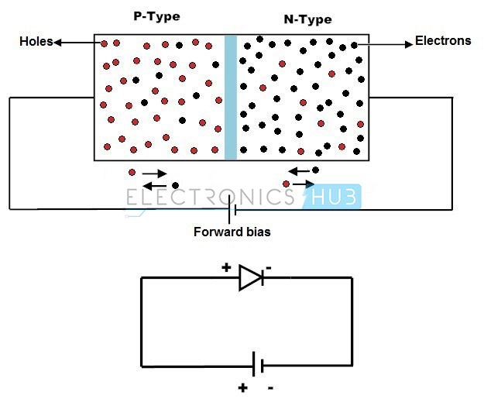
Forward Biased PN Junction Diode
With the externally applied voltage, a potential difference is altered between the P and N regions.
When positive terminal of the source is connected to the P side and the negative terminal is connected to N side then the junction diode is said to be connected in forward bias condition.
Forward bias lowers the potential across the PN junction.

Slide 10
The majority charge carriers in N and P regions are attracted towards the PN junction.
the width of the depletion layer decreases with diffusion of the majority charge carriers.
With the increase in forward bias greater than the built in potential, at a particular value the depletion region becomes very much thinner
so that a large number of majority charge carriers can cross the PN junction and conducts an electric current.
The current flowing up to built in potential is called as ZERO current or KNEE current.

Slide 11
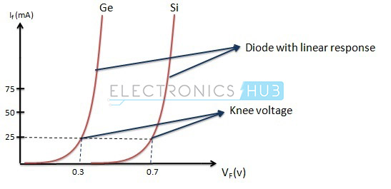
With the increase in applied external forward bias,
the width of the depletion layer becomes thin and forward current in a PN junction diode starts to increase abruptly after the KNEE point of forward I-V characteristic curve.
The forward characteristic of a PN junction diode is non linear, i.e., not a straight line.
This type of forward characteristic shows that resistance is not constant during the operation of the PN junction.
The slope of the forward characteristic of a PN junction diode will become very steep quickly
This shows that resistance is very low in forward bias of the junction diode

Slide 12
The value of forward current is directly proportional to the external power supply and inversely proportional to the internal resistance of the junction diode.
Applying forward bias to the PN junction diode causes a low impedance path for the junction diode, allows for conducting a large amount of current known as infinite current.
This large amount current starts to flow above the KNEE point in the forward characteristic with the application of a small amount of external potential.
The potential difference across the junction is maintained constant by the action of depletion layer.
The maximum amount of current to be conducted is kept limited by the load resistor, because when the diode conducts more current than the usual specifications of the diode,
the excess current results in the dissipation of heat and also leads to severe damage of the device.

Slide 13
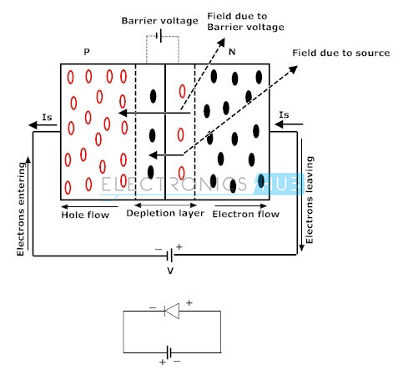
Reverse Biased PN Junction Diode
When positive terminal of the source is connected to the N side and the negative terminal is connected to P side, then the junction diode is said to be connected in reverse bias condition.
In this type of connection majority charge carriers are attracted away from the depletion layer by their respective battery terminals connected to PN junction.

Slide 14
Positive terminal attracts the electrons away from the junction in N side and negative terminal attracts the holes away from the junction in P side.
As a result of it, the width of the potential barrier increases that impedes the flow of majority carriers in N side and P side.
The width of the free space charge layer increases, thereby electric field at the PN junction increases and the PN junction diode acts as a resistor.
But the time of diode acting as a resistor is very low. There will be no recombination of majority carriers taken place at the PN junction; thus, no conduction of electric current.
The current that flows in a PN junction diode is the small leakage current, due to minority carriers generated at the depletion layer or minority carriers which drift across the PN junction.
Finally, the result is that the growth in the width of the depletion layer presents a high impedance path which acts as an insulator.

Slide 15
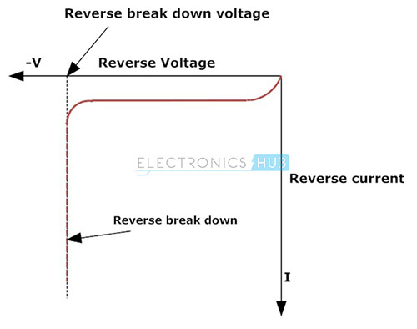
In reverse bias condition, no current flows through the PN junction diode with increase in the amount of applied external voltage.
However, leakage current due to minority charge carriers flows in the PN junction diode that can be measured in micro amperes.
As the reverse bias potential to the PN junction diode increases ultimately leads to PN junction reverse voltage breakdown and the diode current is controlled by external circuit.
Reverse breakdown depends on the doping levels of the P and N regions.
With the increase in reverse bias further, PN junction diode become short circuited due to overheat in the circuit and maximum circuit current flows in the PN junction diode.

Slide 16
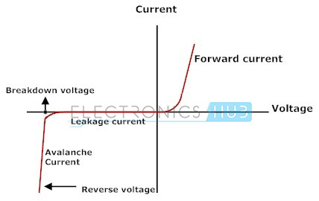
V-I Characteristics of PN Junction Diode
The forward bias characteristic curve of diode is shown in the first quadrant in the figure
the current in the forward bias is incredibly low if the input voltage applied to the diode is lower than the threshold voltage (Vr). The threshold voltage is additionally referred to as cut-in voltage.
Once the forward bias input voltage surpasses the cut-in voltage (0.3 V for germanium diode, 0.6-0.7 V for silicon diode), the current spectacularly increases, as a result the diode functions as short-circuit.

Slide 17
The reverse bias characteristic curve of diode is shown in the fourth quadrant of the figure above.
The current in the reverse bias is low till breakdown is reached and therefore the diode looks like as open circuit. When the reverse bias input voltage has reached the breakdown voltage, reverse current increases spectacularly.

